Slide 1
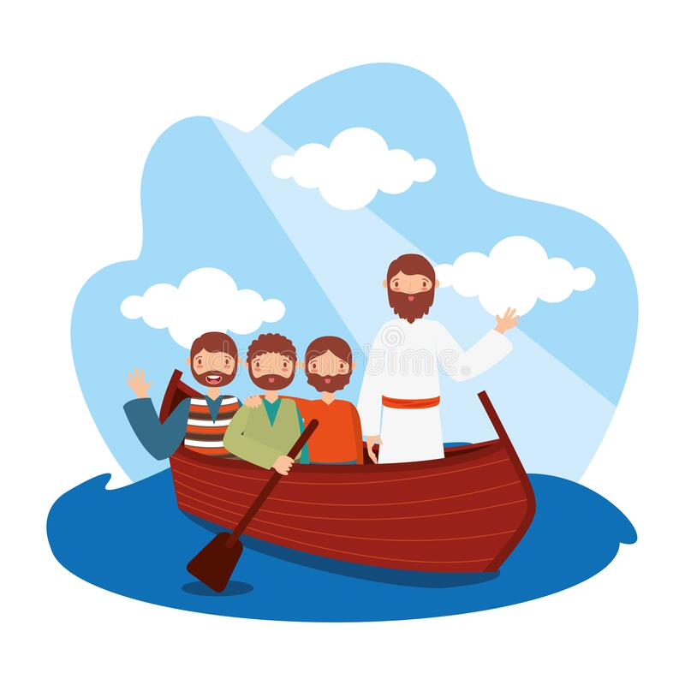
JESUS CHOOSES HIS SPECIAL FRIENDS

Slide 2

Do you have any hobbies?
What are your favourite things to do?

Slide 3
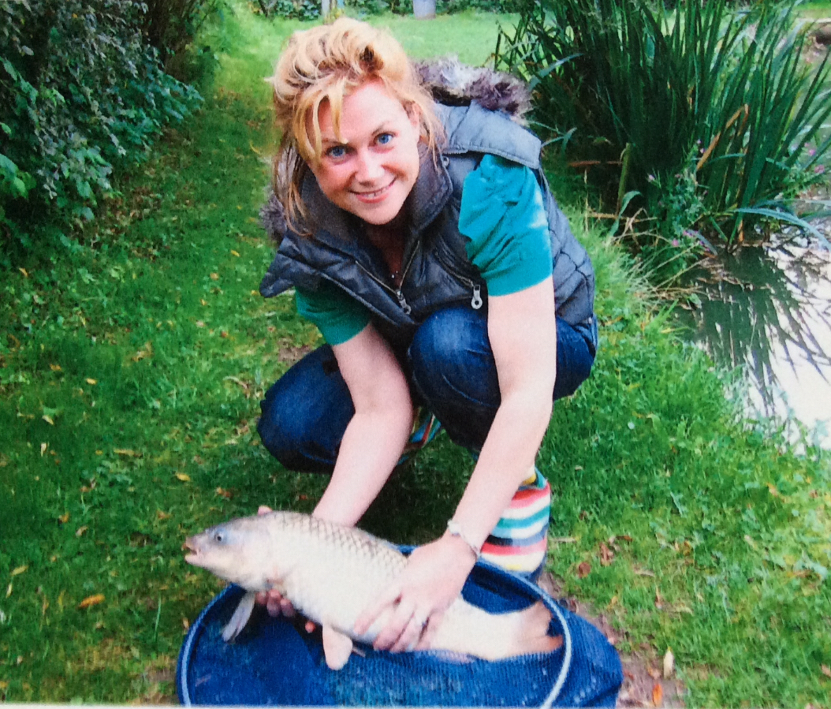
Fishing……. A Prize Carp!

Slide 4
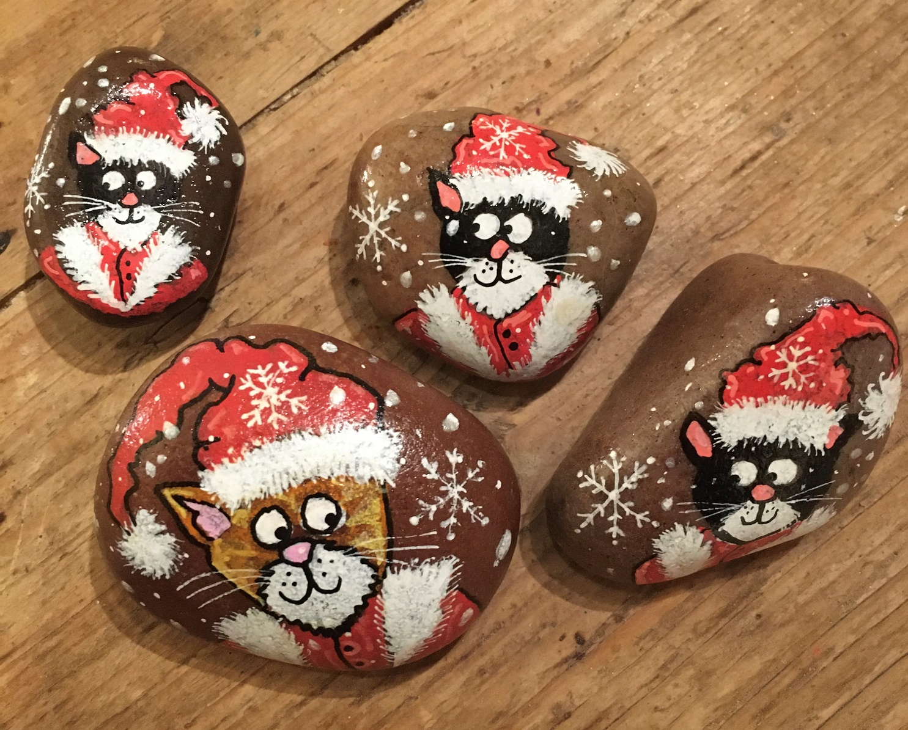
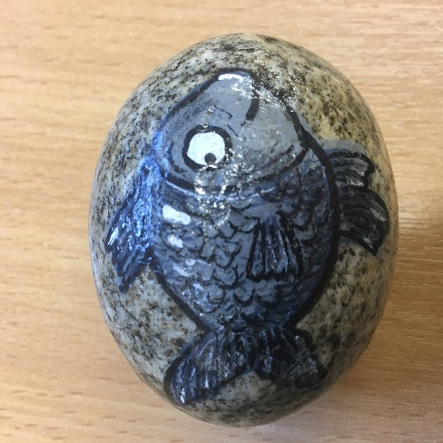
Rock Painting ….

Slide 5


Slide 6
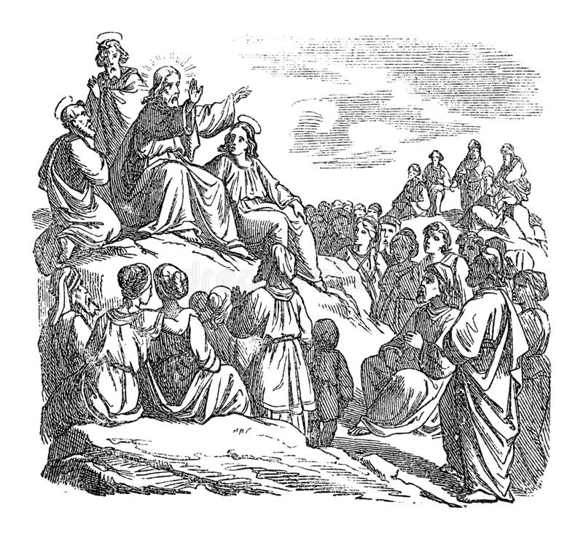
‘Jesus the Story Teller’
- Sea of Galilee
- Crowds of people
- Simon’s Boat
- Fishing – no success
- Try again!
- It’s a miracle ….

Slide 7
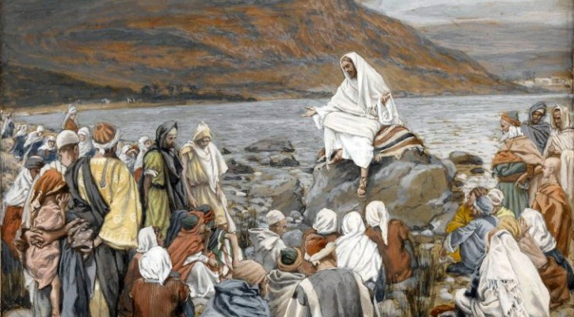
Come and Join Me…..

Slide 8
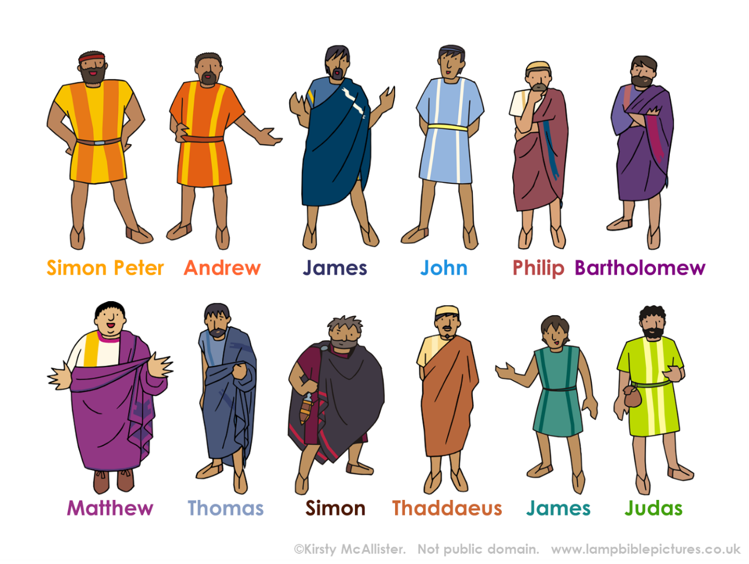
Special Friends = The Disciples

Slide 9


‘Be a Fisher of Men …..’
Helped Jesus spread His wisdom and message – how we should lead our lives in accordance with God (what we say, what we think, what we do)
Help Jesus spread ‘Christianity’ across the region and the world
What would Jesus Do?

Slide 10

A Prayer for My Friends
Lord Jesus,
Thank you for my friends,
for the games and fun that we play,
for the secrets we share,
for the laughs and giggles, for the good times and bad.
Please help me to be a good friend to them.
Amen

