Slide 1
hope….
‘Positive hope in ourselves’

Slide 2
What is the difference between the words ‘hope’ and ‘wish’ ?
Let’s find out…..

Slide 3


Slide 4
Wish = to want something that cannot or probably will not happen….. We can’t really influence it !
I WISH THAT I WOULD NEVER HAVE TO DO HOMEWORK EVER AGAIN !

Slide 5
I Hope….
There is a greater chance that something could actually happen

Slide 6
The story of a man who hoped that jesus could help him
But before that, let’s play a little game…..

Slide 7

Guess the Object….
1. Hairbrush
2. Wooden Spoon
3. Packet of Biscuits
4. Tube of Toothpaste
5. Packet of Tissues

Slide 8
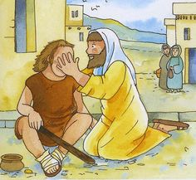
If we didn’t have the descriptions / clues we could simply just look at the objects and recognise them
However, this is not the case for someone who is blind.
Can you imagine what it would be like if you could never see because you were blind – you would have to rely on your other senses instead.
The story of Bartimaeus (Mark Chapter 10 Verses 46 – 52)

Slide 9
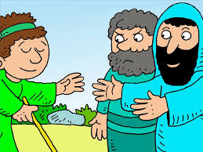
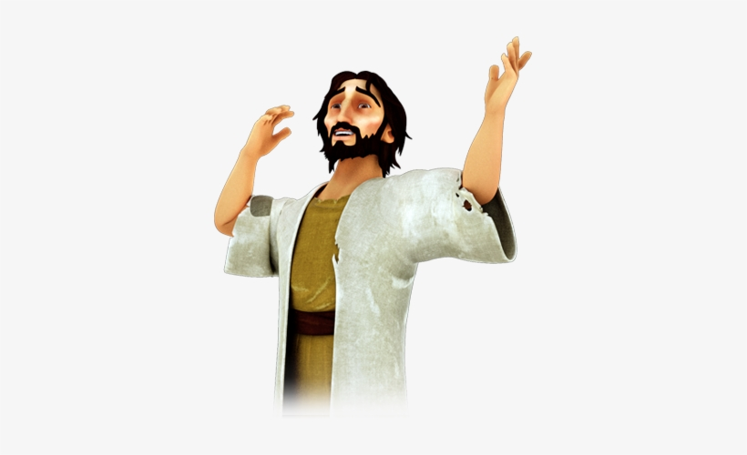
Bartimaeus put his hope in someone he thought could help him - Jesus
He had the faith to believe that Jesus could make him see and he took action to make his hopes become a reality.
A VERY POSITIVE KIND OF HOPE !

Slide 10

Reflect and Respond….
1. Why do you think Bartimaeus might have been a beggar?
2. How do you think Bartimaeus must have felt when he realized that Jesus had healed him and that he could now see?
3. What new things do you think Bartimaeus would have done after he could see?
4. Is there a difference between wishing for something to happen and having hope that something will happen?

Slide 11
Bartimaeus took action to make his hopes to become a reality…. The kind of hope that means that you really believe that something can change for the better and you are willing to do something about it.
‘Agents of Change’

Slide 12
The Trentside Federation – Our Vision ‘Inspired to be the best we can be, through the love of Jesus Christ’ At the Trentside Federation, building a community of hope underpins our vision. We aim to empower everyone through their learning and relationships to contribute to and act on their knowledge and understanding so that all can be ‘agents of positive change’, for ourselves, our schools, our local community and the wider world. Hope and resilience are at the heart of everyone’s learning, encouraging our capacity for reflective thought. We empower through learning, we help everyone become agents of positive change, we foster hope and resilience, we value everyone as they are so that we can build a community of hope. Everyone matters in their uniqueness and everyone is valued.

Slide 13
Positive hope
The kind of hope that means that you really believe that something can change for the better and you are willing to do something about it……

Slide 14

What are your hopes for the future? What are your hopes for this coming year? Are you willing to take the positive steps necessary to make your hopes become a reality? Christians believe that God is interested in every aspect of their lives. They believe that they can ask God to help them fulfil their hopes.

Slide 15

Let Us Pray
Dear Lord
Thank you for today’s story about Bartimaeus.
Thank you that Bartimaeus’ dream came true and that he was able to see again.
Please help us as we move through this year and through the rest of our lives.
Help us to dream big dreams and never to give up hope.
Amen

