Slide 1
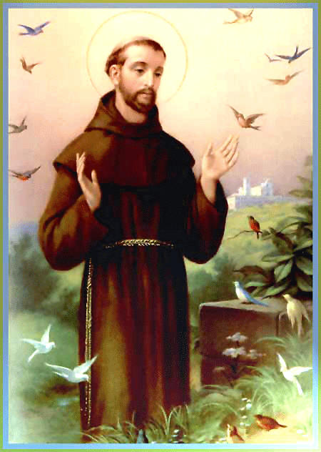
St Francis of Assisi

Slide 2
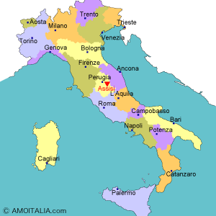
St. Francis was born in Assisi in Italy.
He was very rich and always had really nice clothes and didn’t care about how much money he was spending.
One day, a poor man walked by and asked him for some money. However, he did not give him any, he walked right passed.
But… Francis soon felt bad, ran after the beggar and gave him some money.

Slide 3
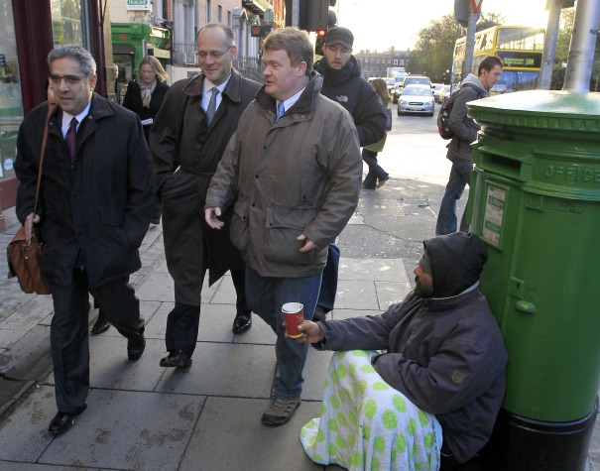

Slide 4
Francis got really ill and when this happened he realised that he should be praying to God and helping others.
He gave his expensive clothes to the poor and he started to wear rags.
His rich father did not like this and kicked him out. His friends started to make fun of him.
He went to visit sick people in hospitals and helped as many people as he could by telling them about God.

Slide 5

Fruits of the Spirit = Our Super Powers....
Love
Joy
Kindness
Patience
Goodness
Faithfulness
Peace

Slide 6
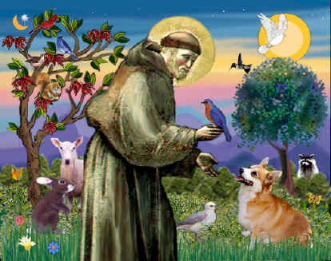
St. Francis loved all creatures. All the animals and birds obeyed him.

Slide 7
Lord, make me an instrument of your Peace!
Where there is hatred, let me sow love;
Where there is injury, pardon;
Where there is doubt, faith;
Where there is despair, hope;
Where there is darkness, light, and
Where there is sadness, joy.
O Divine Master, grant that I may not
so much seek to be consoled as to console;
To be understood as to understand;
To be loved as to love;
For it is in giving that we receive;
It is in pardoning that we are pardoned;
and it is in dying that we are born to Eternal Life.“
Amen

Slide 8
Prayer becomes a Song!
Hymn – Make Me A Channel of Your Peace:
https://www.youtube.com/watch?v=ihhvm6eLWZI

Slide 9
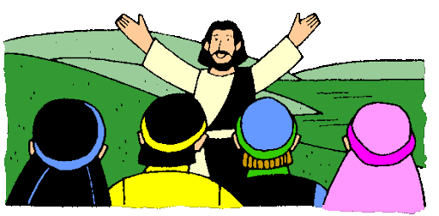
What Does This Mean For Our School Community?
A Community of Hope
Let’s do all we can to
Bring Joy
Forgive
Have Faith
Console
Show Love
‘Inspired to be the best we can be, through the love of Jesus Christ’

Slide 10

What Does the Bible Say?
The Bible encourages us to "let our light shine before others, that they may see your good deeds and glorify your Father in heaven" (Matthew 5:6). The prayer of St Francis reminds us just how we can do that. This is such an encouraging and uplifting prayer that teaches us how we can live like Jesus Christ and serve those around us, putting others needs first.

Slide 11

Hope helps us cope wisely with things and people going wrong. It shows us that bad experiences, bad behaviour and wrong-doing need not have the last word, there is always room for healing situations, forgiveness and reconciliation. Every day is a fresh start. Every dawn is a new beginning…. ‘

Slide 12

A Community of Hope

Slide 13

Let’s Pray
Father,
Thank you that in a world of despair,
You are our Hope.
In a world of darkness,
You are our Light.
In a world of sorrow,
You are our joy.
Help us to share the Hope of our hearts with one another.
Enable us to give Hope to others through Your work amongst us.
We ask this in Jesus’ name,
Amen

