Slide 1
Refugees

Slide 2
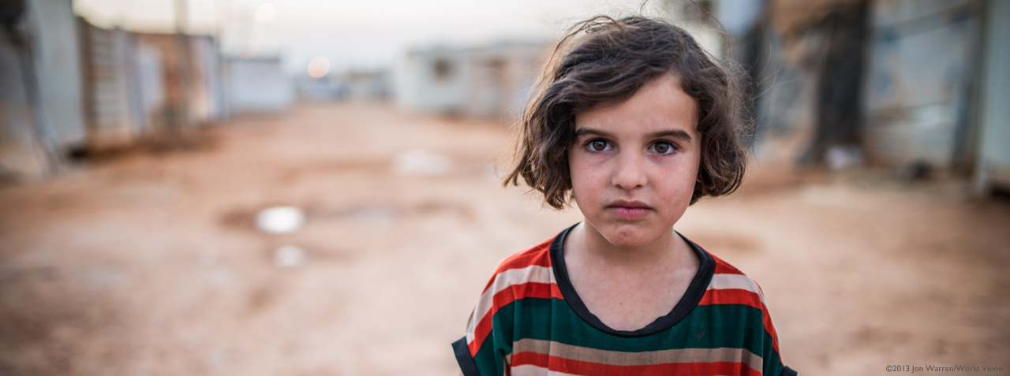
A refugee is someone who has to leave their home and country and find somewhere new to live.

Slide 3
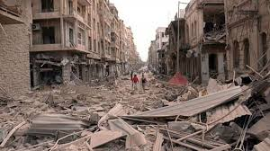
People have to leave a country called Syria because there is fighting there and their homes have been destroyed.

Slide 4
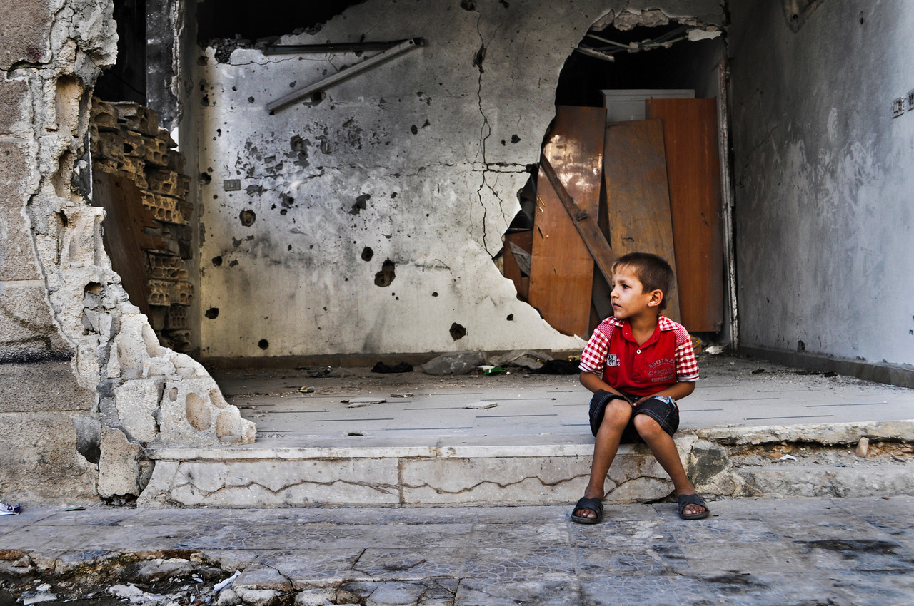
Children have to leave their homes quickly and are not able to take
anything with them. They will probably never go back to their homes.

Slide 5
Think for a moment about what it is like for these children;
think about your home and answer these questions:
What would it be like to have to leave your home quickly?
What one special thing would you take with you?
What would you miss?
How would you feel if you knew you would never see your home
again?

Slide 6
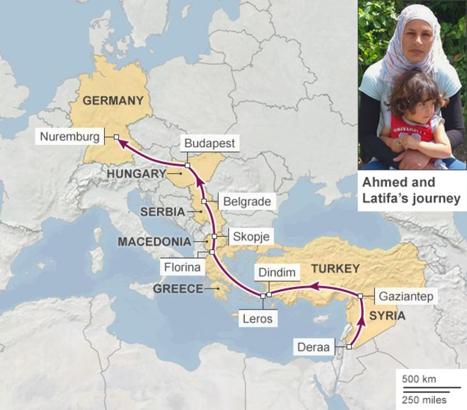
This is the way people travel to get away from Syria and get to Germany. The route is 1815 miles, a very long way.
Can you see England?
Some people carry on travelling to get to England because they want to live here.

Slide 7
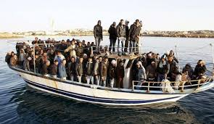
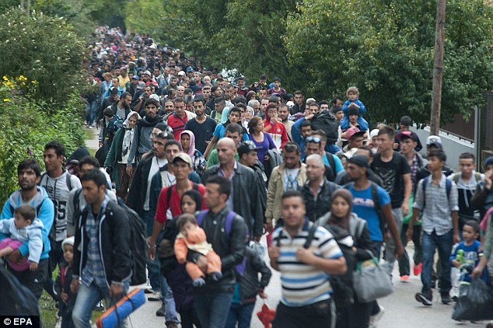
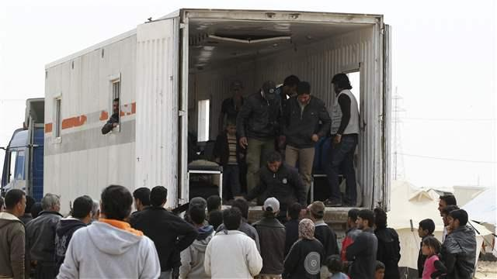
They travel on small overcrowded boats
They walk for miles and miles
They try to ride in lorries

Slide 8
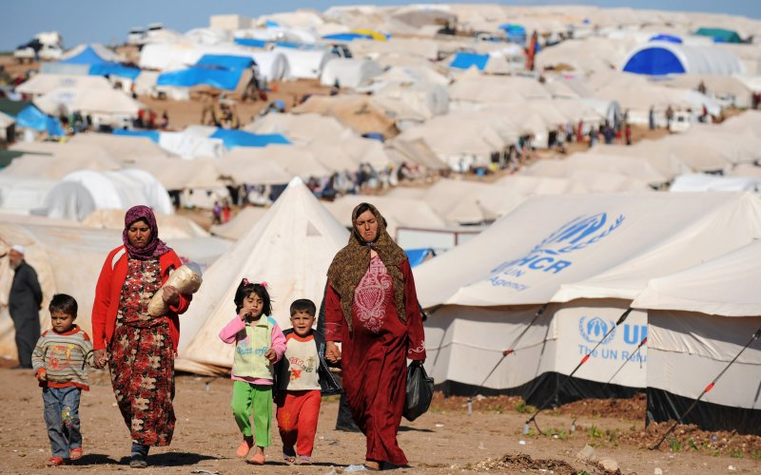
When they arrive in a safe country such as Germany or England they stay in a special camp with lots of other refugees.
They stay in the camp until the people in charge of the country can find them a house to live in.

Slide 9
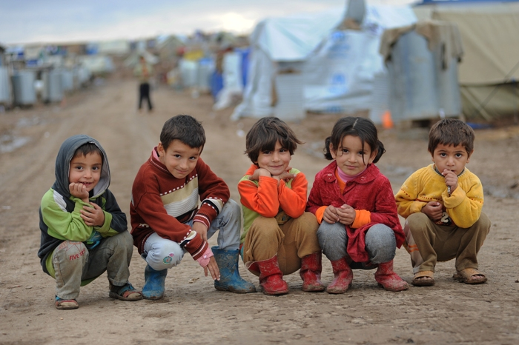
What do you think a child living in a refugee camp would need?
What would you like to give a little girl or boy living in a camp?

Slide 10
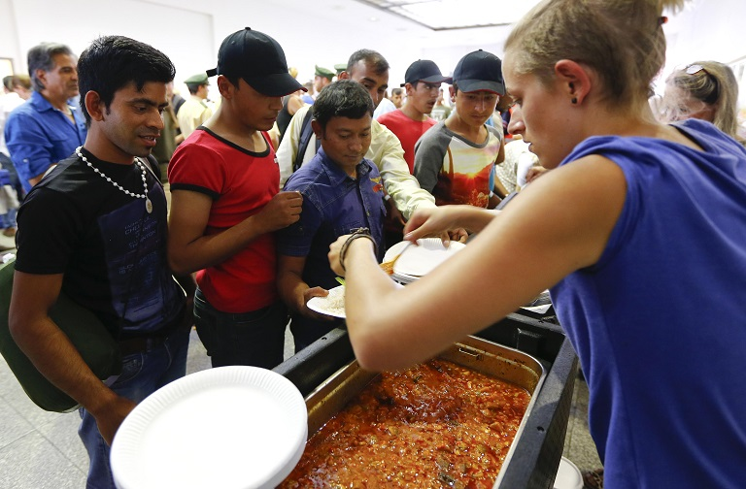
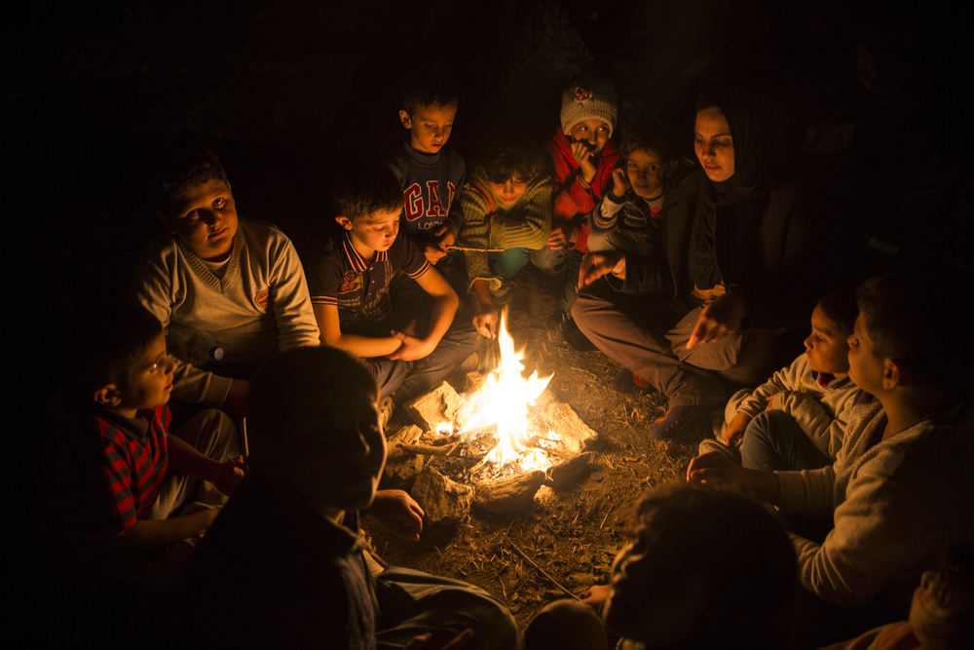
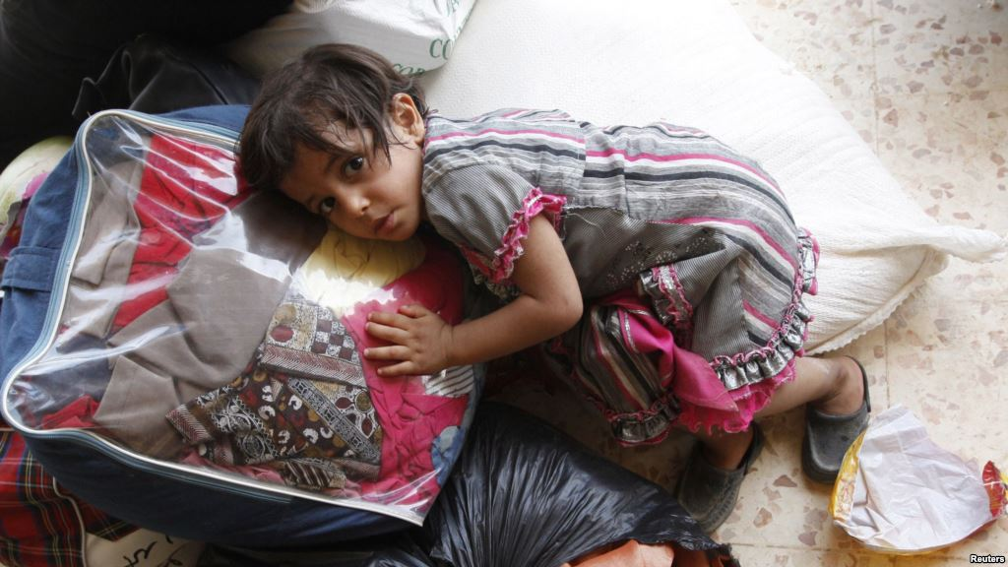
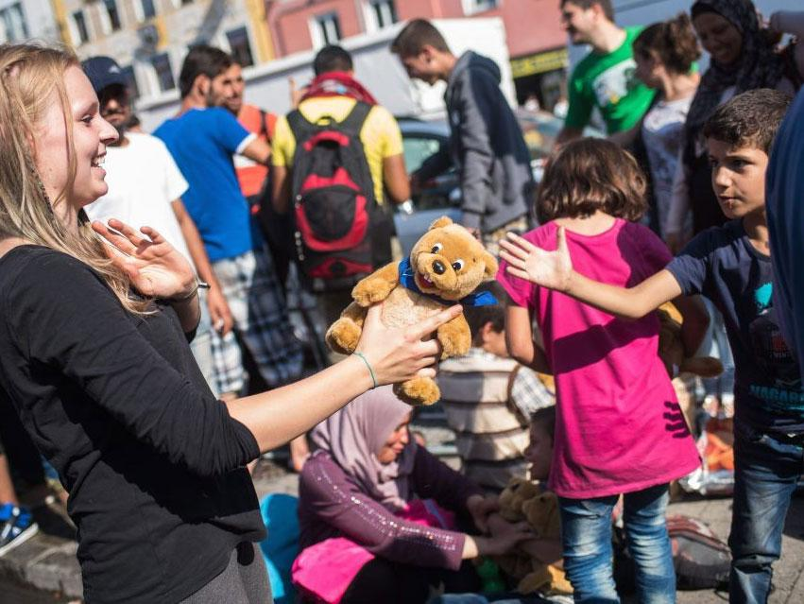
They need:
Water and food
Firewood and sleeping
bags to keep warm
Toys

Slide 11

Jesus wants us to look after refugees, he said,
‘ I was hungry, and you gave me food. I was thirsty, and you gave me something to drink. I was alone and away from home, and you invited me into your house. I was without clothes, and you gave me something to wear. I was sick, and you cared for me. I was in prison, and you visited me.’
“Then the good people will answer, ‘Lord, when did we see you hungry and give you food? When did we see you thirsty and give you something to drink? When did we see you alone and away from home and invite you into our house? When did we see you without clothes and give you something to wear? When did we see you sick or in prison and care for you?’
‘I tell you the truth. Anything you did for any of my people here, you also did for me.’

Slide 12
Our Vision – ‘Community of Hope’

Slide 13
What can we do?
We can have a good attitude to refugees and want to help them.
We can do things to raise money for them.
We can give food and clothes to collections for them.
Jesus said that when we care for people in need it is as if we are caring for him.

Slide 14
Prayer
Dear Jesus, thank you for our homes and this safe country that we live in.
Help us to remember the children who don’t have nice homes and a safe country and who have travelled a long way to find a new place to live.
Please help us to look after them and help our leaders find them somewhere to live.
Amen

